Slide 1


CAREPOINT
DOCTOR APPOITMENT SYSTEM
CREATED BY:-
Samrath Abak - 250843020002
Abhijeet Mele - 250843020003
Digvijay Lohar - 250843020030
Gaurav Shiromani - 250843020035
SUBMITTED TO:-
Mrs. Bakul Joshi

Slide 2
WHAT IS CAREPOINT ?
CarePoint is a smart, web-based healthcare management system designed to simplify and digitize patient care operations. It provides a centralized and secure platform that connects patients, doctors, and healthcare staff, enabling efficient management of medical records, appointments, and consultations for a seamless healthcare experience.
01
02
03
SMART PATIENT MANAGEMENT
ONLINE APPOINTMENT BOOKING
TRUSTED PLATFORM
Easily search, view, and manage patient details, medical history, and treatment records in a structured and organized manner.
Patients can book appointments online, while doctors can manage schedules and consultations digitally.
Role-based access, verified users, and secure handling of medical data ensure privacy, reliability, and trust.

Slide 3
WHY CAREPOINT ?
CarePoint solves the key challenges of traditional healthcare management by providing a fast, secure, and fully digital platform. It simplifies patient record management, appointment scheduling, and medical consultations for healthcare providers, enables efficient workflow management for doctors and staff, and ensures better control, data accuracy, and monitoring through a centralized admin-managed system.
01
02
03
CENTRALIZED HEALTHCARE PLATFORM
EFFICIENT MEDICAL MANAGEMENT
SECURE & RELIABLE
All patient records, appointments, and medical histories are managed in one centralized system for easy access and tracking.
Doctors and healthcare staff can manage consultations, prescriptions, and medical records digitally with improved efficiency.
Role-based access, authenticated users, and secure data handling ensure privacy and reliability of sensitive medical information.

Slide 4
SYSTEM USERS
The system supports multiple user roles to ensure efficient access control and smooth management of healthcare operations.
The users involved in the project are:-
  Healthcare Staff / Admin
  Patient
  Doctor
01
02
03
HEALTHCARE STAFF / ADMIN
PATIENT
DOCTOR
Oversee system operations, manage users, monitor appointments, and ensure smooth workflow across the platform.
Can register, log in, book appointments, and access their medical records digitally.
Manage appointments, view patient history, add diagnoses, and update medical records.

Slide 5
PROJECT ARCHITECTURE
01
05
The application is divided into three main layers: Front End, Middle Layer (Microservices), and Database Layer.
A Service Discovery mechanism is used to dynamically register and locate services within the system.
02
06
The Front End is developed using React.js, HTML, CSS, and Bootstrap, and runs on a web server at localhost:3000.
Each service handles a specific business responsibility such as user management, appointment scheduling, or medical records.
03
07
The Middle Layer consists of independent microservices built using Spring Boot and ASP.NET Core.
Each service handles a specific business function and communicates using REST APIs with JSON format.
04
08
An API Gateway acts as a single entry point for all client requests and routes them to the appropriate services.
The database layer follows a per-service approach to ensure loose coupling, using MySQL with JPA/Hibernate for Spring Boot services and Entity Framework for .NET services.

Slide 6
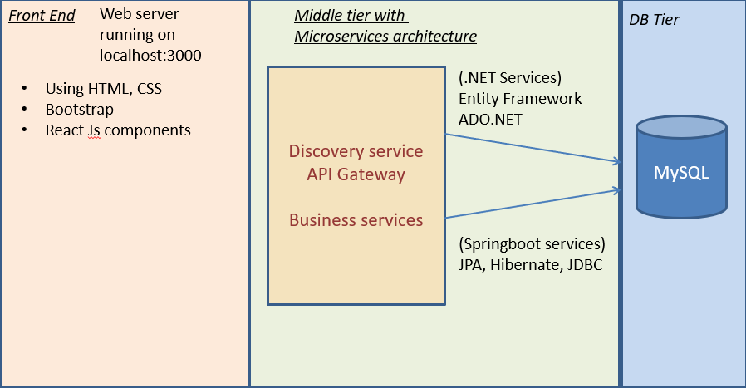
PROJECT ARCHITECTURE

Slide 7
FRONTEND WORKFLOW
01
05
Users interact with the system through a React-based user interface.
Requests are routed to respective RESTful API endpoints via the API Gateway.
02
06
Each application screen is developed as a modular React component with appropriate UI controls and form validations.
The backend processes the request and returns a response or status message.
03
07
Client-side validation is performed using JavaScript logic and regular expression patterns to ensure data correctness.
Based on the response, the frontend displays success messages or error notifications.
04
08
After successful validation, the frontend communicates with the backend using Axios.
For successful operations, the UI is updated dynamically or the user is redirected to the relevant page.

Slide 8
MICROSERVICES ARCHITECTURE AND WORKFLOW
01
05
The Carepoint system is designed using a
Microservices Architecture, where each service
is developed and deployed independently.
Each microservice handles a specific business function such as user management, appointment scheduling, or medical records.
02
06
All client requests first reach the API Gateway, which acts as a single entry point for the system.
Microservices communicate with each other using REST Template and exchange data in JSON format.
03
07
The Discovery Service maintains a registry of all available microservices and their network
locations.
Each service uses shared database, ensuring data isolation and loose coupling.
04
08
Based on the request type, the API Gateway forwards the request to the appropriate microservice.
After processing, the service sends a response back through the API Gateway to the frontend.

Slide 9
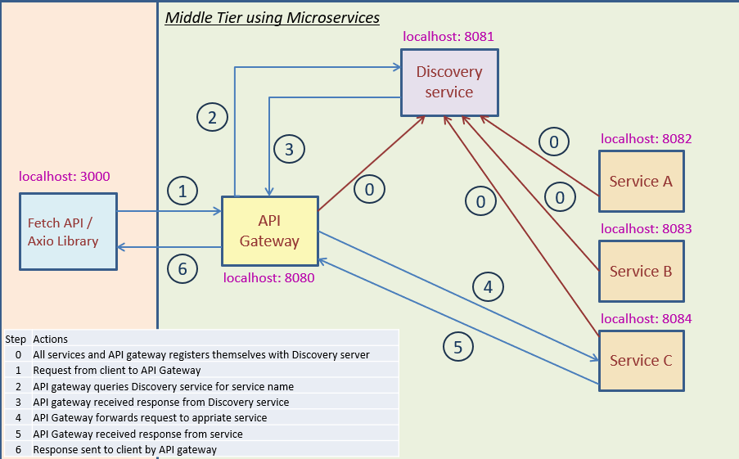
MICROSERVICES ARCHITECTURE AND WORKFLOW

Slide 10
SYSTEM SERVICES
The system is divided into multiple independent services to ensure scalability and maintainability.
The services used in the project are:
  User Service (Spring Boot)
  Appointment & Scheduling Service (Spring Boot)
  Medical Records Service (ASP.NET Core)
01
02
03
USER SERVICE
APPOINTMENT & SCHEDULING SERVICES
MEDICAL RECORDS SERVICE
This service manages user registration, login, and authentication. It also handles role-based access for Admin, Doctor, and Patient to ensure secure system usage.
This service manages doctor appointment booking and scheduling by validating availability and appointment status to prevent conflicts.
This service stores and manages patient medical records such as diagnosis and prescriptions. It ensures secure and authorized access to sensitive healthcare data.

Slide 11
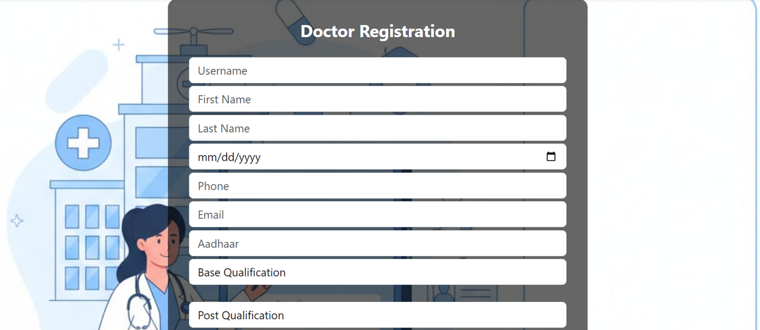
USER SERVICE -
DOCTOR REGISTRATION
FUNCTIONALITIES
  Allows doctors to register with personal and professional details.
  Validates registration data and credentials.
  Doctor accounts require admin verification before activation.
  Provides role-based access to doctor-specific features.
  Ensures secure authentication and authorization.
WORKFLOW
  Doctor submits registration details.
  System validates input fields and password rules.
  Account is created in pending state.
  Admin verifies and activates the doctor account.
  Doctor logs in and accesses the dashboard.

Slide 12
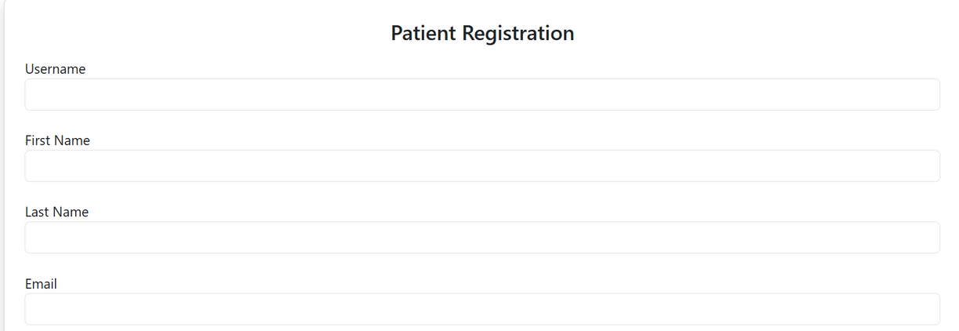
USER SERVICE -
PATIENT REGISTRATION
FUNCTIONALITIES
  Allows patients to register and manage their accounts.
  Validates user inputs and prevents duplicate registrations.
  Patient accounts are activated immediately after registration.
  Provides secure access to patient-specific features.
  Supports password management and profile updates.
WORKFLOW
  Patient submits registration details.
  System performs input validation.
  Account is created and activated.
  Patient logs in to access services.
  Patient uses system features like booking appointments and viewing records.

Slide 13
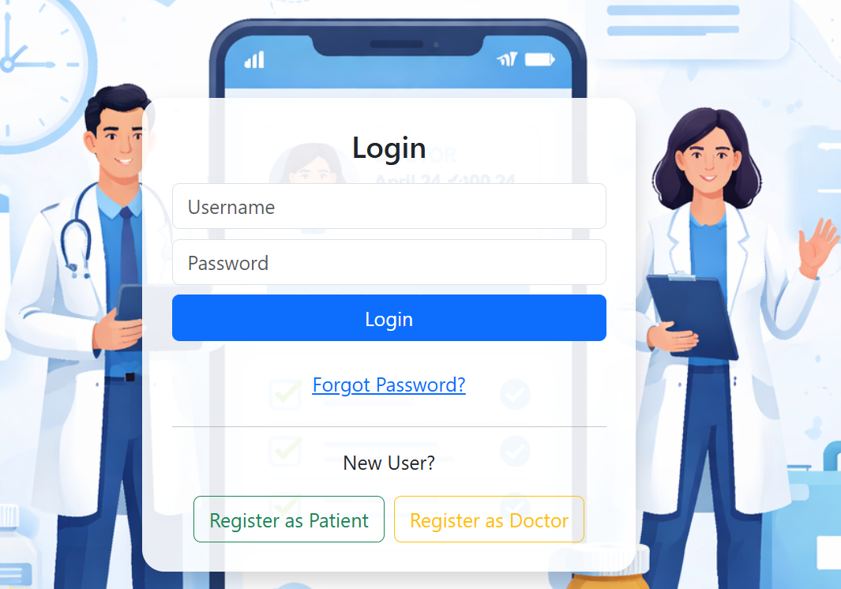
USER SERVICE -
LOGIN
FUNCTIONALITIES
  Supports login for Patient, Doctor, and Admin roles.
  Validates credentials securely.
  Implements role-based authentication.
  Redirects users to respective dashboards.
  Handles invalid login attempts gracefully.
WORKFLOW
  User enters login credentials.
  System validates input fields.
  Credentials are authenticated.
  User role is identified.
  User is redirected to the appropriate dashboard.

Slide 14
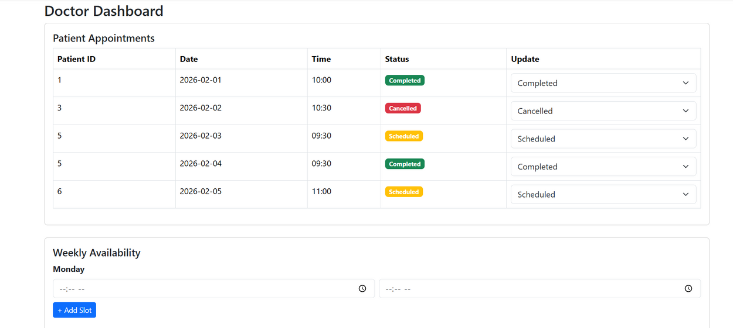
APPOINTMENT & SCHEDULING SERVICE - DOCTOR
FUNCTIONALITIES
  Manage availability and time slots.
  View scheduled appointments.
  Accept or reject appointment requests.
  Track appointment status.
WORKFLOW
  Doctor defines availability slots.
  Views incoming appointment requests.
  Accepts or rejects appointments.
  Appointment status updates automatically.
  Doctor manages daily schedule.

Slide 15
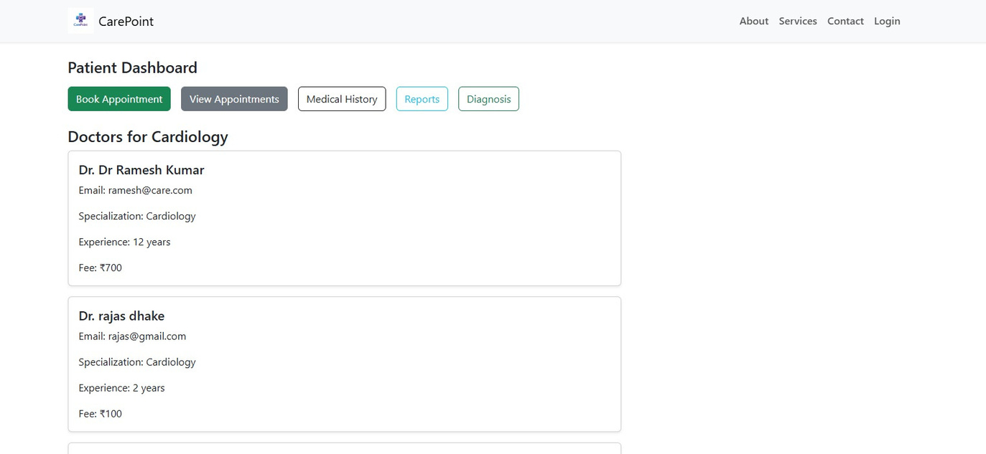
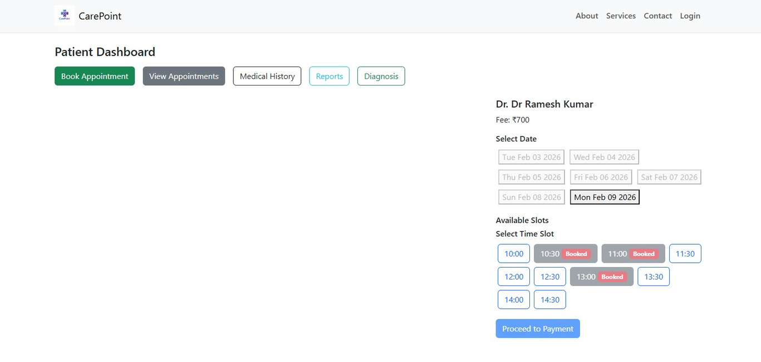
APPOINTMENT & SCHEDULING SERVICE - PATIENT
FUNCTIONALITIES
  Search doctors and view doctor details.
  Book, reschedule, or cancel appointments.
  View appointment status and history.
  Receive confirmation and status updates.
WORKFLOW
  Patient searches for doctors.
  Selects an available time slot.
  System validates availability and confirms booking.
  Patient can reschedule or cancel if required.
  Appointment status is updated accordingly.

Slide 16
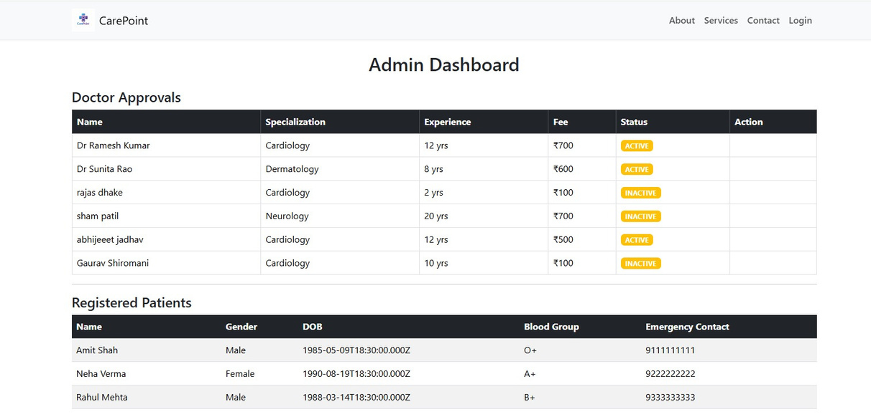
APPOINTMENT & SCHEDULING SERVICE - ADMIN
FUNCTIONALITIES
  Monitor all appointments across the system.
  Track appointment lifecycle and activities.
  Ensure smooth scheduling operations.
  Resolve conflicts or issues if required.
WORKFLOW
  Admin monitors appointment data.
  Reviews booking, rescheduling, and cancellations.
  Tracks system activity and usage.
  Takes action in case of conflicts or anomalies.

Slide 17
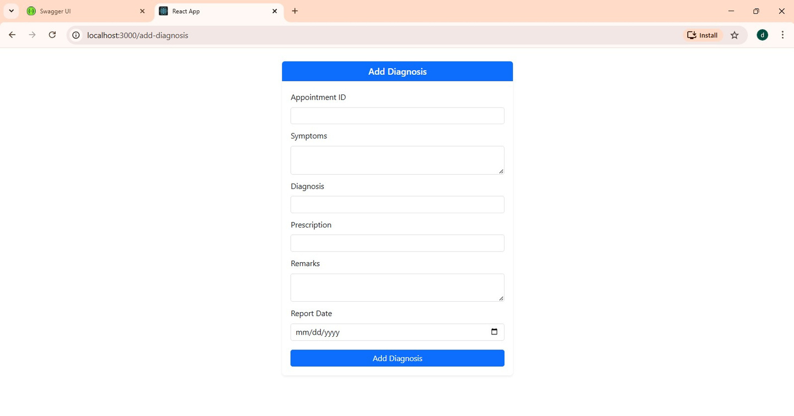
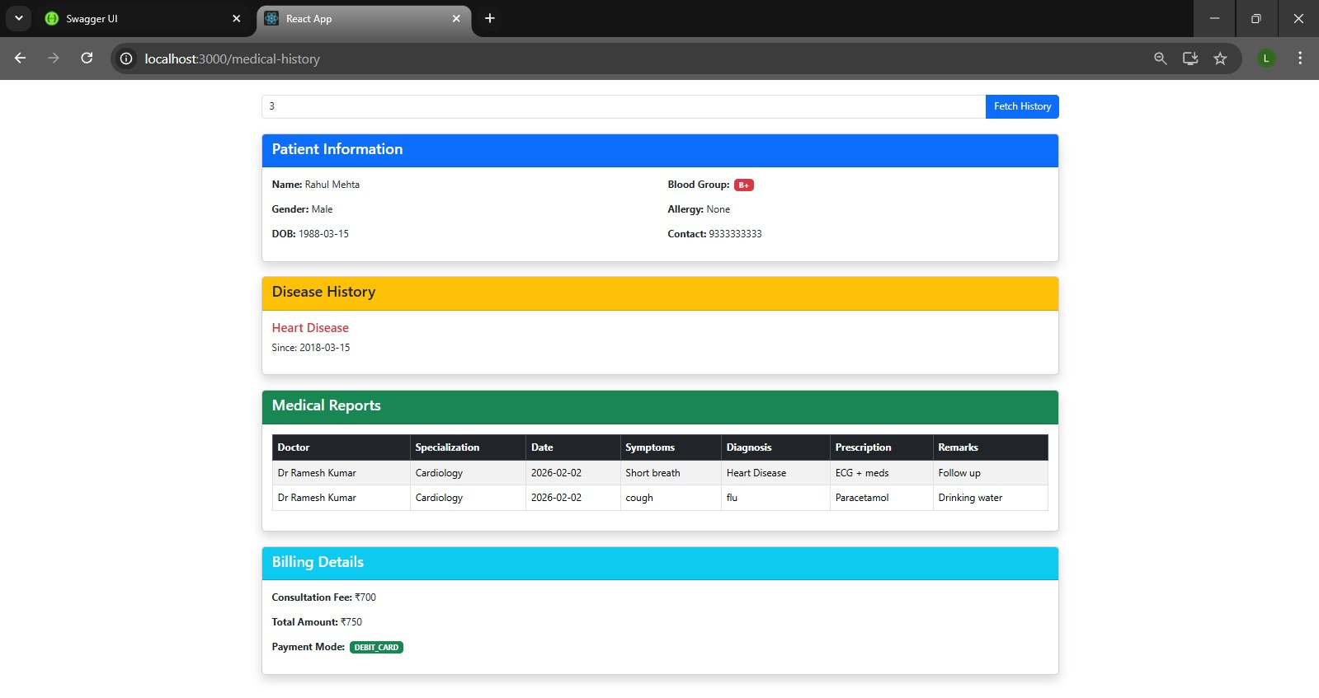
MEDICAL RECORDS SERVICE-DOCTOR
FUNCTIONALITIES
  Add diagnosis and prescriptions for patients.
  Create and update patient medical records.
  Generate and view medical reports.
  Access medical data based on assigned role and permissions.
WORKFLOW
  Doctor selects a patient profile.
  Adds diagnosis and prescription details.
  Medical records are securely stored and linked to the patient.
  Doctor generates medical reports for review or analysis.

Slide 18
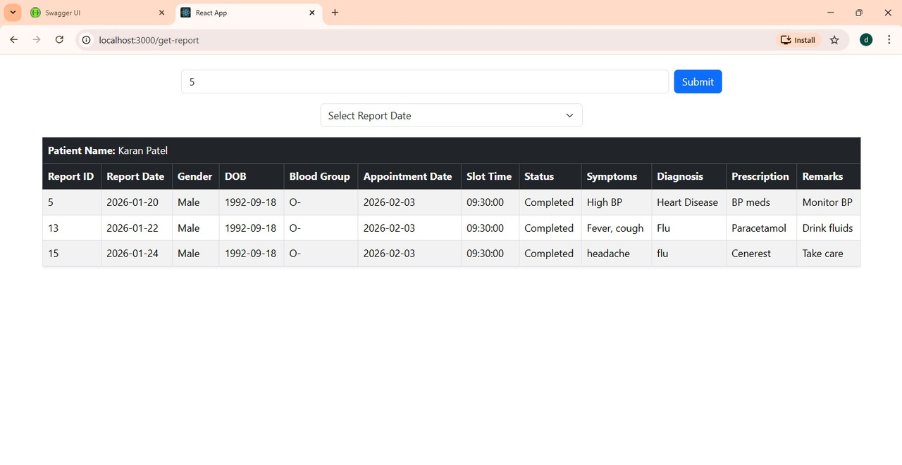
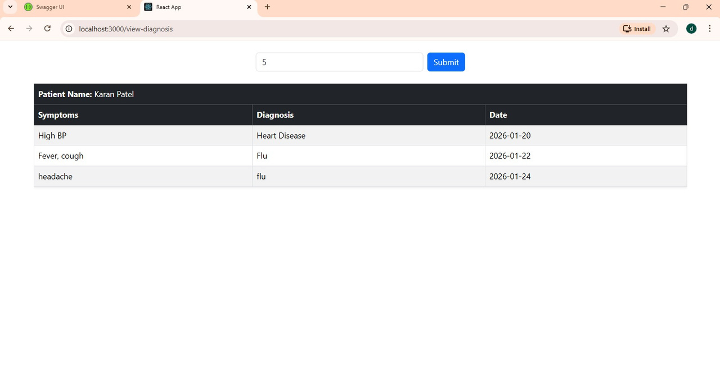
MEDICAL RECORDS SERVICE-PATIENT
FUNCTIONALITIES
  View personal medical history and records.
  Access diagnosis, prescriptions, and reports.
  Ensure secure and read-only access to medical data.
WORKFLOW
  Patient logs into the system.
  Accesses medical history and reports.
  Data is displayed securely based on role permissions.

Slide 19
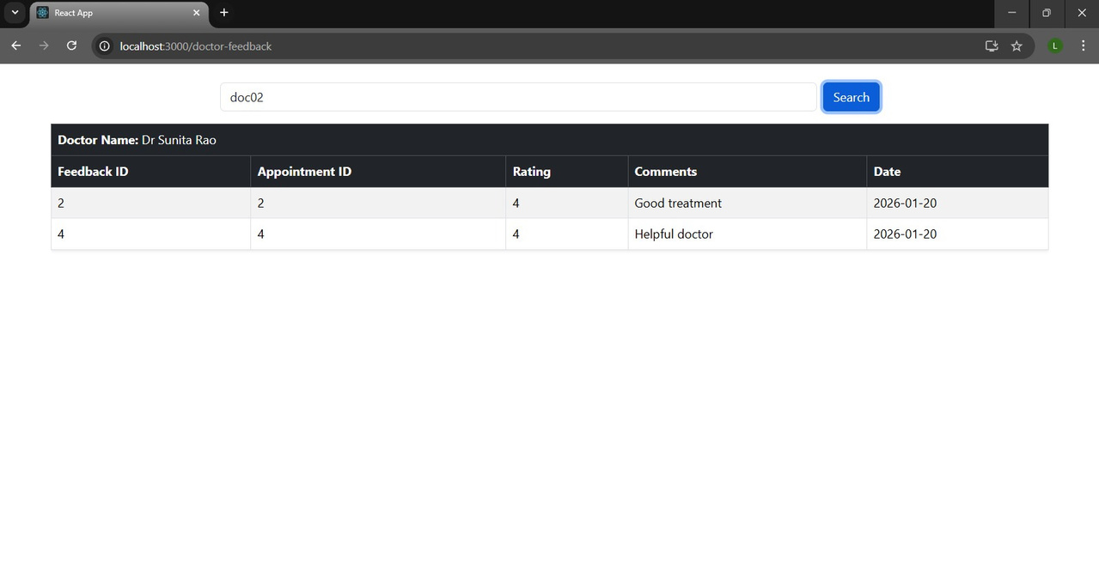
MEDICAL RECORDS SERVICE-ADMIN
FUNCTIONALITIES
  Monitor medical record activities.
  Ensure secure access and compliance.
  Manage role-based permissions.
WORKFLOW
  Admin oversees medical data usage.
  Ensures role-based access control is enforced.
  Monitors system activity for security and compliance.

Slide 20
Video Consultations:-
Enable doctors and patients to have real-time virtual consultations.
Integration with scheduling and medical records for seamless workflow.
Mobile Application Development:-
Develop Android & iOS apps to provide on-the-go access for patients and doctors.
Push notifications for appointments, test results, and reminders.
AI & Predictive Health Analytics:-
Implement AI-based suggestions, such as risk alerts, diagnosis hints, or treatment
recommendations.
Data-driven insights for patient management and hospital efficiency.
Automated Notifications & Reminders:-
Automated SMS/email/app notifications for
upcoming appointments, lab results, or follow- ups.
Cloud Deployment & Scalability:-
Deploy on cloud for better performance, security, and scalability.
Easy integration with additional modules in future.
FUTURE EXTENSIONS

Slide 21
THANK YOU

